Slide 1
Building an ABM Chpts. 6, 4, & 5

Slide 2
Verifying/Debugging
Typos
Syntax errors
Runtime errors
Misunderstanding primitives
Logic errors
Formulation errors

Slide 3



Common Errors
Syntax errors
Misunderstanding primitives
Setup structure and test one line at a time (works for submodels too)
Most common issue with Netlogo
ifelse condition
[ ]
[ ]
ifelse condition
[x = 1]
[ ]
ifelse condition
[x = 1]
[x = 2]
Let neighbor-turtles turtles in-radius 2
Let neighbor-turtles turtles-on patches in-radius 2
Patch context
Turtle context
Notes:
Same concept applies for testing submodels. Get them working separately and then integrate

Slide 4
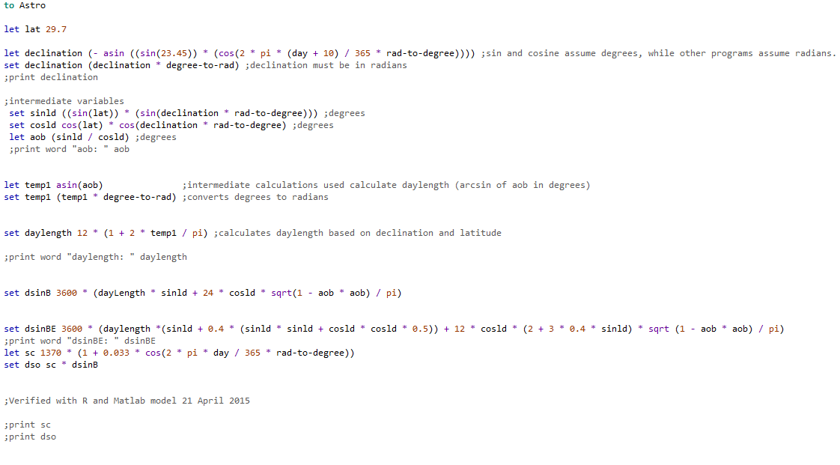
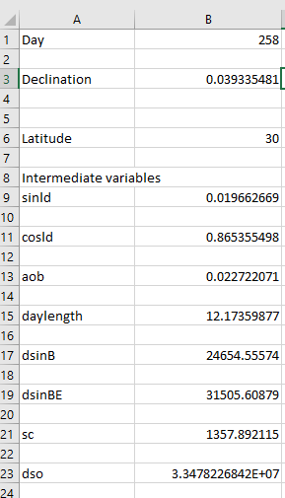
Identifying Errors
Implement in other software
Use print statements liberally
set C-alpha map [x -> x ^ (- alpha)] C
print word "C: " C
set WC-alpha (map * W-Vect C-alpha)
print word "WC: " WC-alpha

Slide 5
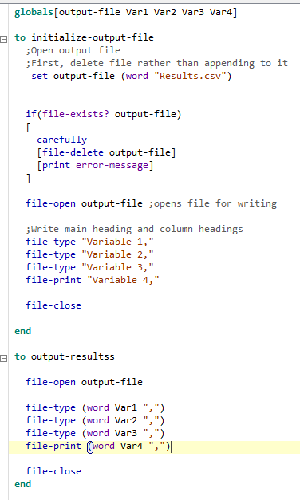
Output
Create output files to analyze data or test procedures
Output procedure provided in class folder. (Output.nlogo)
Primitives to know
File-open
File-close
File-delete
File-type
File-print

Slide 6
Building the model
1
What’s the first step?

Slide 7
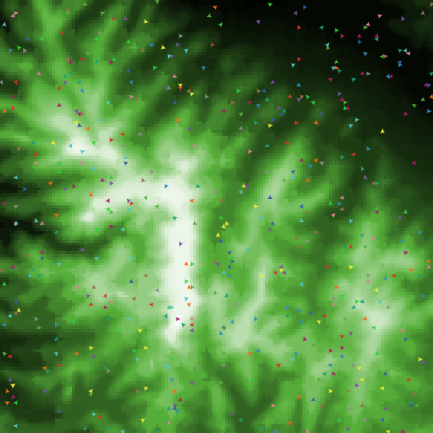
Virtual Corridors
Develop an ABM to test virtual corridors
Recreate model of Pe’er et al 2005

Slide 8
Model Objective
Determine if interactions between butterflies and landscape topography (hill topping) can create virtual corridors

Slide 9
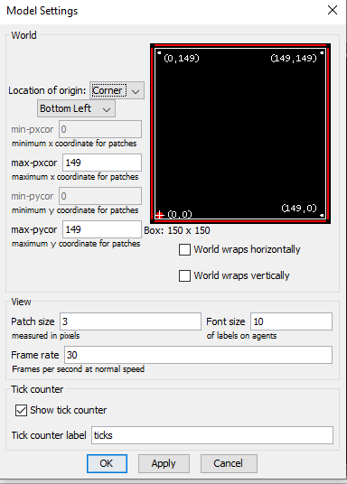
Building the model
2) Define state variables (check code)
globals-own [ ]
Patches-own [ ]
Turtles-own [ ]
3) Create patch attribute elevation (check code)
Patches-own [Elevation]
USE COMMENTS (;)
1) Set up world (150 x 150 patches)

Slide 10

4) Set up setup and go procedures (check code & SAVE)
To setup
[
ca ;clears all variables
ask-patches
[
;do something
]
]
Reset-ticks
End
What is the code for go and step?

Slide 11
Assignment
Complete the model in chapter 4.
Create 500 turtles and have them move uphill based on a random number function.
Run for 1000 ticks
Note general trends

Slide 12
Netlogo primitives to learn
Ask
Move-to
Uphill
Neighbors
One-of
Setxy
random
Pxcor, pycor
Create-turtles (crt)
Clear-all (ca)
Reset-ticks
Stop
to, end

Slide 13
Onwards to Science!
2
Let’s start with the first set of slides

Slide 14
Scientific models
Move past visualizations into modeling for science
What are some ways we could make this model more realistic?

Slide 15
Working with output
Defining the patterns of expected behavior helps identify output

Slide 16

Science up the model
Calculate the average width of corridors used by butterflies
Plot corridor width on the interface at the end and over time
Export the plots and graph 5 different scenarios
Import real landscape, scale the color, run the model again

Slide 17
Netlogo primitives to learn
Export
Min/max
To-report
File-open, file-close, file-at-end
While
Not
Next-X, Y, variable
Patch-here
True/false
Count
Mean
Let/set
With
Scale-color

Slide 18
Developing your own model
It’s kinda hard
Go slow
Use your conceptual model as a template
Build one component first, get it to work, then move on.
Add interactions piecemeal
The dictionary and examples will be helpful
Don’t get too frustrated. We’re here to help.
Power of psuedocode
If you get stuck, create a bulleted list of what you want the model to do
Psuedocode: plain language description of code blocks

